Slide 1
CI/CD Design for DAT
Name: DAT
Date:

Slide 2
Agenda
CICD General Design: 3 - 11
CICD for Python code: 12 – 29
CICD for sql code: 30 - 36

Slide 3
Definition: CI/CD is a continuous Integration, Continuous Delivery, and Continuous Deployment. It is a software development approach that focuses on automating the processes involved in building, testing, and deploying applications. CICD aims to improve the efficiency, quality, and speed of software delivery by reducing manual interventions and streamlining the entire software development lifecycle.
Continuous Integration (CI):
Developers write code and push it to a version control system, such as Git.
In the CI/CD code the source code management will be defined to pull the developer’s code into CI/CD to perform deployments.
In the CI/CD code the source code management will be defined to pull the developer’s code into CI/CD to perform deployments.
Automated tests are executed to verify the correctness and quality of the code.
If the build and tests pass successfully, the changes are integrated into the main codebase, ensuring that the software is always in a releasable state.

Slide 4
Continuous Delivery (CD):
After successful integrated in CI stage, the application is automatically deployed to a staging environment or a pre-production environment.
In the staging environment, further testing, including
performed to ensure that the application behaves as expected.
Once the tests pass in the staging environment, the application is ready for release

Slide 5
Continuous Deployment (CD):
After the application passes the tests in the staging environment, it is automatically deployed to the production environment.
The deployment process typically involves steps like deploying the application to production servers, configuring necessary infrastructure, and performing any required data migrations.
Continuous monitoring and logging are crucial to detect and respond to any issues or errors in the production environment.

Slide 6
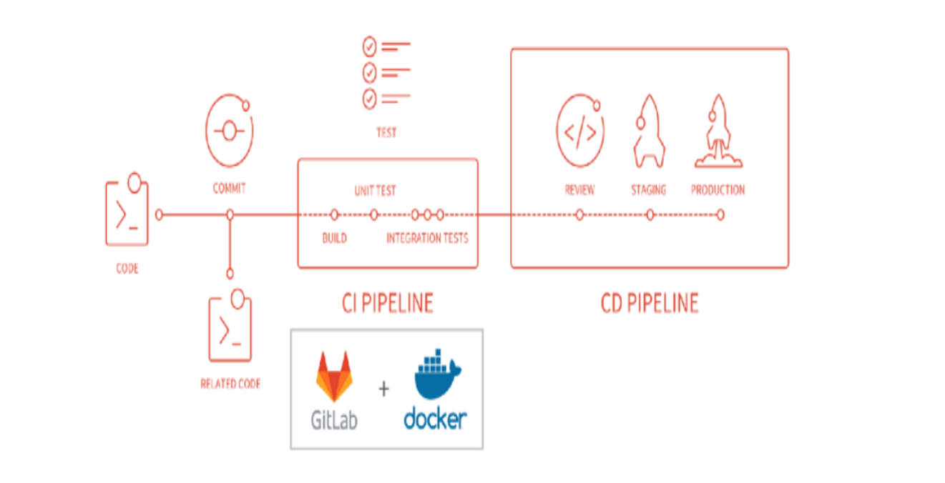
Architecture Diagram:
02

Slide 7
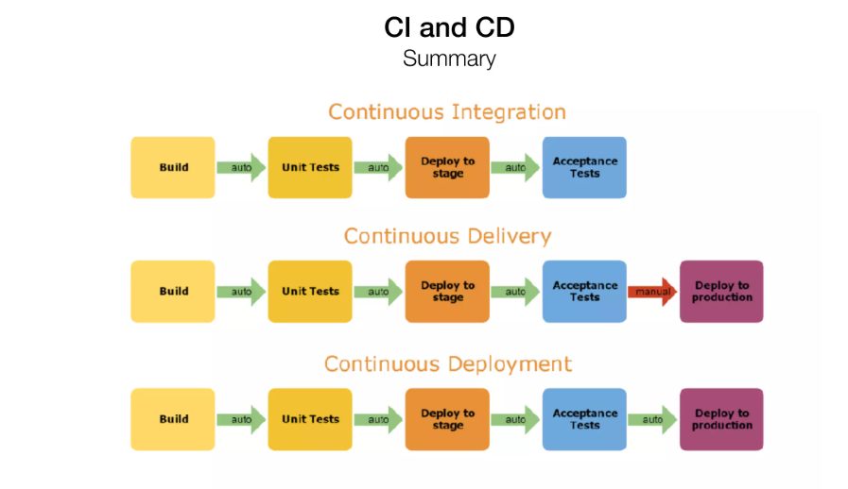
CI/CD Summary
03
Section subtitle
max. over two lines

Slide 8
Steps for CI/CD
Set up a GitLab Repository:
Create a new GitLab repository to host your project.
Initialize your project with a .gitlab-ci.yml file. This file will define the CI/CD pipeline stages and jobs.
Define Pipeline Stages and Jobs:
In the .gitlab-ci.yml file, define the stages and jobs for your pipeline. Common stages include build, test, deploy, and release. You can customize these stages based on your project requirements.
Each stage contains one or more jobs that define specific tasks to be executed.
Configure CI Runners:
CI runners are responsible for executing the pipeline jobs. Configure CI runners either by setting up GitLab's shared runners or by registering your own runners.
GitLab provides various types of runners, such as dedicated runners, shared runners, group runners and Choose the runner type that suits your project.
04

Slide 9
Implement Pipeline Jobs:
Define the jobs within each stage of the pipeline.
For example, in the build stage, you can have a job that checks out the source code, compiles dependencies, and builds the application
Add Testing and Quality Checks:
Include jobs for running automated tests, static code analysis, and any other quality checks specific to your project.
This ensures that your code meets the required standards before proceeding to deployment.
Implement Deployment Jobs:
Depending on your project, deployment jobs can involve tasks like pushing code to a remote server, provisioning infrastructure.

Slide 10
Configure Pipeline Triggers:
GitLab provides various ways to trigger the pipeline, such as on every commit, on tags, or manually. Configure the triggers based on your workflow requirements.
Monitor and Review Pipeline Results:
Define jobs to deploy your application to the desired environments, such as development, staging, and production.
Monitor the environment infrastructure and application performances using the different metrics in monitoring tools by integrating to our environments.
We can enable the logging groups to track the logs in monitoring tools and use the notification services also.

Slide 11
Best Practices:
Implement caching mechanisms to clean the other files and libraries in pipeline jobs to enhance the performance of the pipeline.
Leverage GitLab CI/CD variables to store and manage environment-specific configuration values, secrets, and other parameters. This ensures better portability and security of your pipeline.
Utilize GitLab's built-in monitoring features or integrate with external monitoring tools to collect and analyse pipeline performance metrics. Identify bottlenecks, resource constraints, or frequent failures to continuously improve your pipeline.
Maintain up-to-date documentation that outlines the purpose, structure, and usage of your CI/CD pipeline. This helps onboard new team members and ensures consistency across projects.

Slide 12
Python CI/CD
Name: DAT
Page:

Slide 13
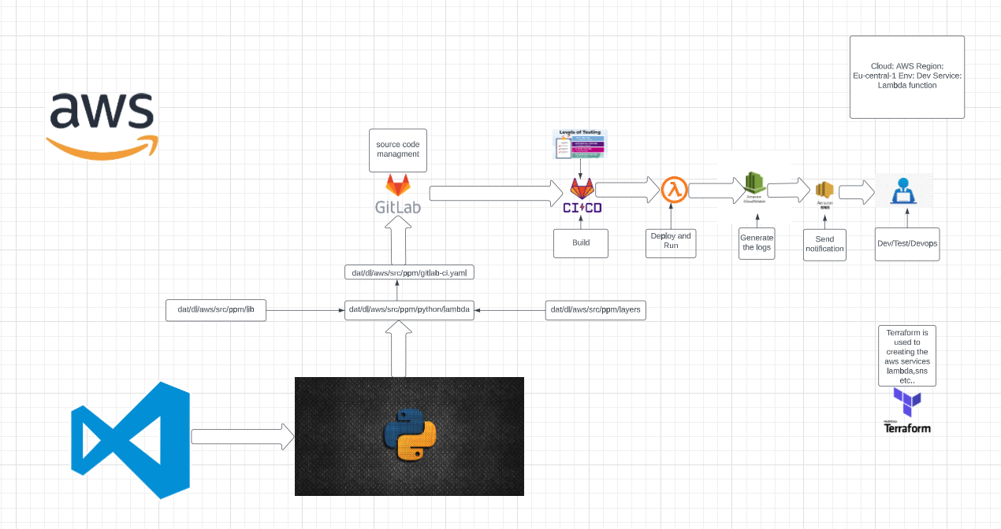
Python CI/CD

Slide 14
CI/CD for Python code in DAT
Create a GitLab Repository:
Start by creating a new repository on GitLab to host your Python code. You can do this by navigating to GitLab and following the steps to create a new project.
Create a python/lambda folder under the DAT/dl/aws/src/ppm folder which contains the layers, application folders and there is a lib folder within the ppm path which contains the database and repository frameworks which is related to application folders(for example redshify_copy folder will call the base.py file from the connections folder).
Inside the application folder we will have _init_.py, handler.py, service.py files and tests folder
Inside the test folder we can find the testcases which is related to this application(for example redshift_copy).
Inside the layers folders will have a different folders like psycopg2 and requests folders which are some dependencies(contains libraries like requirments.txt) to this redshift_copy folder.

Slide 15
Create GitLab Runner:
Install and configure a GitLab Runner, which is responsible for executing jobs in your CI/CD pipeline. You can install the runner on your own infrastructure or use shared runners provided by GitLab.
In our CICD we are using shared runners to doing the deployment those are “docker-shared-cicd” runner.
Configure GitLab CI/CD:
In your GitLab repository, create a file named .gitlab-ci.yml at the root level. This file defines the stages, jobs, and scripts for your CI/CD pipeline.
As per DAT we have to keep this file at dat/dl/aws/src/ppm path.
Configure GitLab CI/CD environment varaibles :
Configure the environment variables like aws credentials and other parameters in gitlab varabiles(under the settings we can find).

Slide 16
Configure unit cases and integrate test cases:
Unit tests are focused on testing individual components or units of code in isolation. They verify that each unit functions correctly according to its specifications.
In DAT unit test cases will be defined at dat/dl/aws/src/ppm/python/lambda/redshift_copy/tests/ path, this testcases will be defined on test stage in .gitlab-ci.yaml.
Integration tests validate the interactions between different components or systems. They ensure that the integrated parts of your application work together as expected. Integration tests often involve external dependencies or resources, such as databases, APIs, or external services.
In DAT integrate test cases will be defined at dat/dl/aws/src/ppm/python/lambda/redshift_copy/integrate_tests/ path, this testcases will be defined on test stage in .gitlab-ci.yaml.
Whenever any test cases will fail automatically the pipeline will be terminated.

Slide 17
Deployment Strategy:
Define the deployment strategy based on your infrastructure requirements. For example, deploying to AWS Lambda and ec2, currently we are using Lambda to push the python codes.
Once the code is pushed into aws console it will test, run, generate logs and send notifications to respected users.
We can choose the options to select the environments(dev or prod) details while run the pipeline.
Use infrastructure provisioning tools like Terraform to define your infrastructure as code. Automate the creation of required resources, such as Lambda functions or EC2 instances.

Slide 18
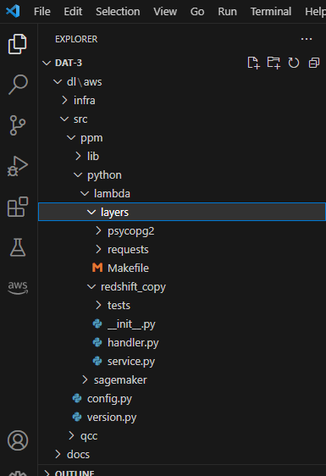

Slide 19
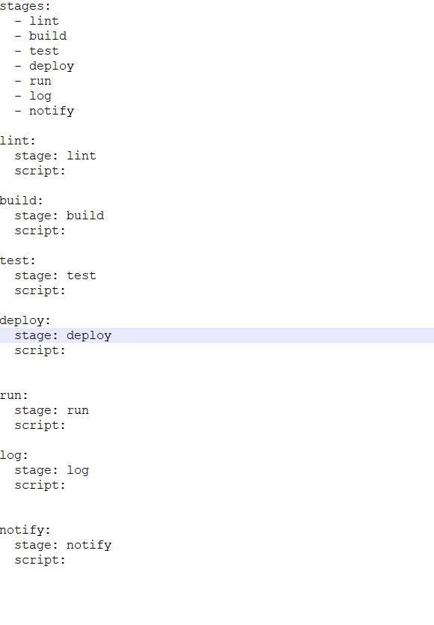
Sample code

Slide 20
Gitlab-ci.yaml
In this yaml file will have a five stages lint, test, integrate test, build, sonarqube and deploy stage
Lint: It is used to check the syntax of all .py files in python/lambda repo.
Test: This stage is used to perform unittests on the above python lambda files.
Integrate Test: This stage is used to perform integrate tests on the above python lambda files.
Build: This stage is used to build and generate a artifact files in zip format for deploymet.
Sonarqube: This stage will perform quality check on python codes it will generate the reports.
Deploy: This stage will be deploy the zip file in to aws lambda function.
Log: In this stage aws cloudwatch will generate the logs for lambda functions, it will stored the logs in loggroup.
Notify: This stage will send the notification and logs through SNS service to developers/testers/devops.
The pipeline will be triggered based on the below condtions
Whenever any changes done by developer in python/lambda folders then he/she will commit the changes into local to remote branch.
Whenever the changes merge from feature branch to master then the pipeline will be triggered.
We need to select the parameters(select the folders where the changes done from python/lamda) while run the pipeline.

Slide 21
SQL CI/CD
Name: DAT

Slide 22
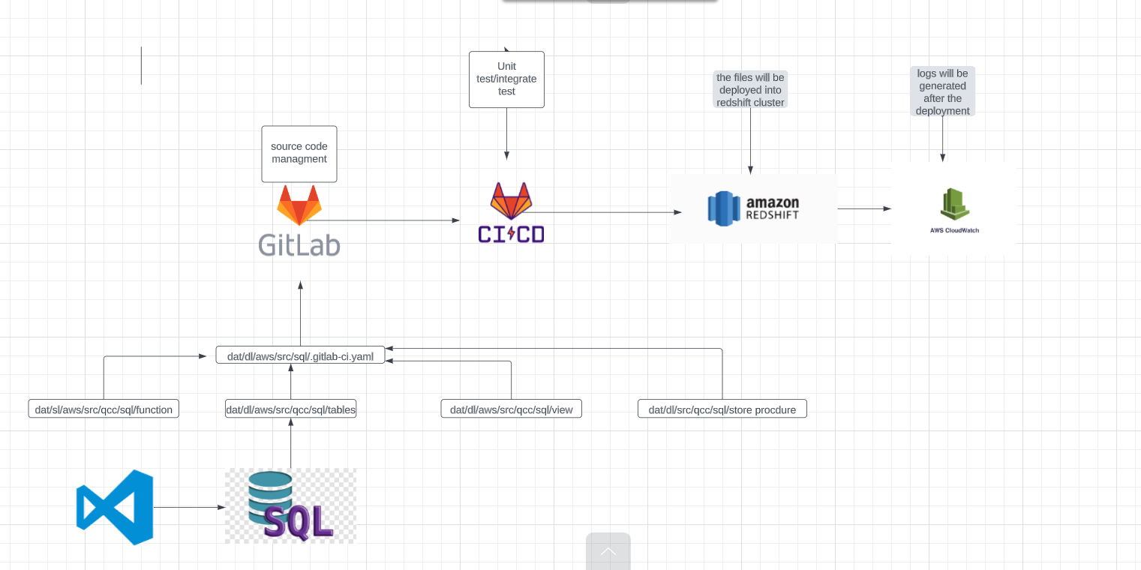

Slide 23
CI/CD for sql code in DAT
Create a GitLab Repository:
Start by creating a new repository on GitLab to host your sql code. You can do this by navigating to GitLab and following the steps to create a new project.
Create a sql folder under the DAT/dl/aws/src/ppm folder which contains the function, stored_procedure, table, view folders.
In each folder it contains different sql files for creating a Tables, functions, views and stored procedure in Redshift db cluster
Currently in DAT we are using dat-redshift-cluster in dev environment.
For db details use the below confluence link:

Slide 24
Create GitLab Runner:
Install and configure a GitLab Runner, which is responsible for executing jobs in your CI/CD pipeline. You can install the runner on your own infrastructure or use shared runners provided by GitLab.
In our CICD we are using shared runners to doing the deployment those are “docker-shared-cicd” runner.
Configure GitLab CI/CD:
In your GitLab repository, create a file named .gitlab-ci.yml at the root level. This file defines the stages, jobs, and scripts for your CI/CD pipeline.
As per DAT we have to keep this file at dat/dl/aws/src/ppm/sql path.
Configure GitLab CI/CD environment varaibles :
Configure the environment variables like aws credentials and other parameters in gitlab varabiles(under the settings we can find)
For db credentials we can define in the aws secrets manager, in the pipeline we can pull db credentials using aws command.

Slide 25
Configure unit cases and integrate test cases:

Slide 26
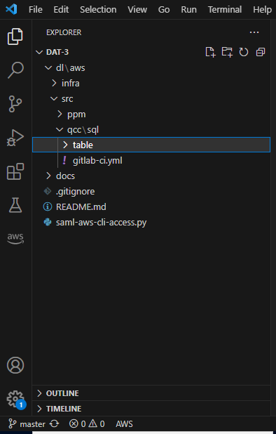

Slide 27
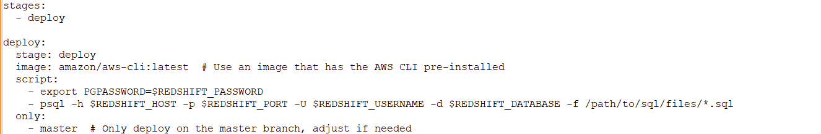
Sample code

Slide 28
Test: This stage is used to run the unit test and integrate test cases on sql files and if any test cases will fail the pipeline will be terminated.
Deploy: This stage is used to deploy the sql files into aws redshift cluster.
The pipeline will be triggered based on the below conditions
Whenever any changes done by developer in dat/dl/aws/src/qcc/sql/* then he/she will commit the changes into local to remote branch.
Whenever the changes merge from feature branch to master then the pipeline will be triggered.
We need to select the parameters(select the folders where the changes done from dat/dl/aws/src/qcc/sql/* while run the pipeline.

Slide 29
Deployment Strategy:
Set up an AWS Redshift Cluster: provision the Redshift cluster using terraform automation by creation the scripts this scripts will be run using the terraform pipeline.
Once the code is pushed into aws console it will test, run, generate logs and send notifications to respected users.
Implement versioning and release management practices to keep track of deployments and manage multiple environments (e.g., development, production).
Use infrastructure provisioning tools like Terraform to define your infrastructure as code. Automate the creation of required resources, such as Redshift cluster and other services.

Slide 30
Terraform CI/CD
Name: DAT

Slide 32
CI/CD for Terraform code in DAT
Infrastructure Provisioning:
Use Terraform to define your infrastructure as code (IaC) and store the Terraform configurations in a version control system, such as GitLab's repository.
Organize your Terraform code into modules for reusability and maintainability.
In DAT Repo will have tf scripts in dat/dl/aws/infra/terraform/cicd/tf path.
Here we have modules, environement/dev and other tf files like main.tf, provider.tf, terraform.tfstate, datasources.tf and backend.tf files.
In modules folder will have aws-redshift, aws-iam, aws-dynamodb, aws-backend and other service folders in each folder we have a tf files which defines the resource block and parameters with respect to aws services.
Main.tf file is defines the folders inside the modules to execute the tf scripts.
Provider.tf file will define the aws details like region and profile.

Slide 33
GitLab Runner:
Set up GitLab Runners, which are agents responsible for running CI/CD jobs.
Install and configure GitLab Runner on your own infrastructure (e.g., EC2 instances) or use GitLab's shared Runners.
We are using a shared runner in DAT CI/CD that is “docker-shared-cicd”

Slide 34
GitLab CI/CD Configuration:
.gitlab-ci.yaml is defined at dat/dl/aws/infra/terraform/cicd path.
In this file we have different stages like validate, plan, apply and destroy stage.
To doing this we need a aws credentials and terraform image and nexus repository to download the terraform image.
Once the pipeline is executed we can validate the results at pipeline output and aws console to review the aws services which is created by this tf scripts.
And state file will be stored in s3 bucket.

Slide 35
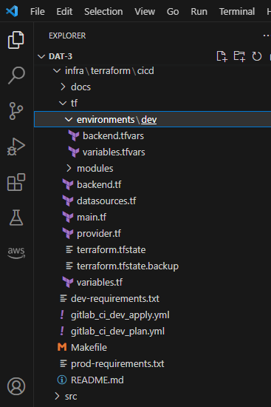

Slide 36
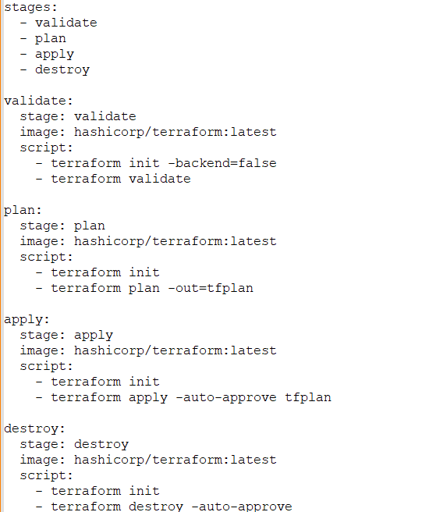

Slide 38
Thankyou
Name: Mugulla Srinivas
Project: DAT

